Slide 1

MINOR PROJECT PRESETATION on DIGITAL FILTER DESIGN IN MATLAB
Presented
By:-
Akshit Mridul (1504439)
Ayan Debnath (1504472)
Santrupta Mishra (1504421)
Shubham Saurav (1504429)
Under the Supervision of
Dr. Sananda Kumar
School of Electronics Engineering,
Kalinga Institute of Industrial Technology (KIIT) University
Bhubaneswar-751024

Slide 2
Outline:
1. Overview
2. Introduction to Filters
3. Digital Filters
4. Preference over analog
FIR and IIR Filters
Filters based of cutoff range
7. Significance of Order
8. Power Spectral Density
9. Objective
10. Tools Used
11. Static FIR Filter design
12. Simulation Results
13. Future scope

Slide 3
Overview:
Communication
Any transfer of signs, signals, writing, images, sounds, data, or intelligence of any nature transmitted in whole or in part by a medium of propagation
Threats In Communication
Presence of noise in Channel
Inter-Symbol Interference
Multipath Propagation
Solution
Channel equalization deals with eliminating these parameters. In this minor project, we shall deal with the first aspect i.e. removal of noise from an input signal.

Slide 4
Introduction to Filters:
A filter is a device or process that removes some unwanted components or features from a signal i.e. some frequencies or frequency bands.
Filters are widely used in electronics and telecommunication, in radio, television, audio recording, radar, control systems, music synthesis, image processing, and computer graphics.

Slide 5
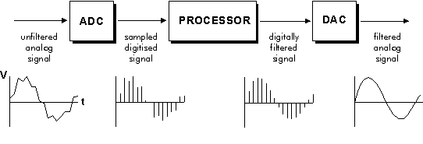
Digital Filters:
A digital filter is a system that performs operations on a sampled, discrete-time signal to reduce or enhance certain aspects of that signal.
This is in contrast to the other major type of electronic filter, the analog filter, which is an electronic circuit operating.
Fig: A Digital Filter

Slide 6
Preference over Analog:
They have linear phase response.
Thermal and environmental variation cannot affect the performance.
They are called adaptive filters because the frequency response can be adjusted automatically with implementation of a programmable processor.
It is possible to filter several input sequences without any hardware replication.
All data can be stored.
They have repeatable performance unit to unit.
Due to them operating at low frequencies, they are used where the use of analog system is impractical.

Slide 7
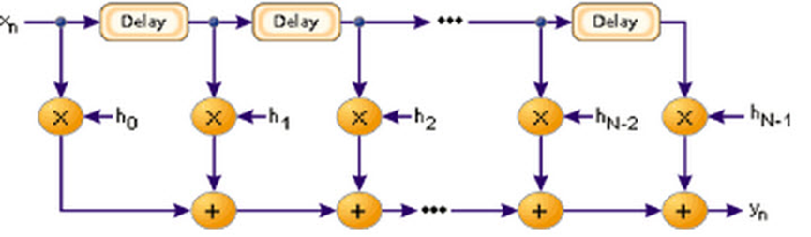
FIR Filters :
An FIR is a filter whose impulse response is of finite period.
The impulse response of an Nth order discrete time FIR filter takes precisely N+1 samples before it then settles to zero.
FIR filters are most popular kind of filters executed in software and these filters can be continuous time, analog or digital and discrete time.
Fig: A basic FIR filter

Slide 8
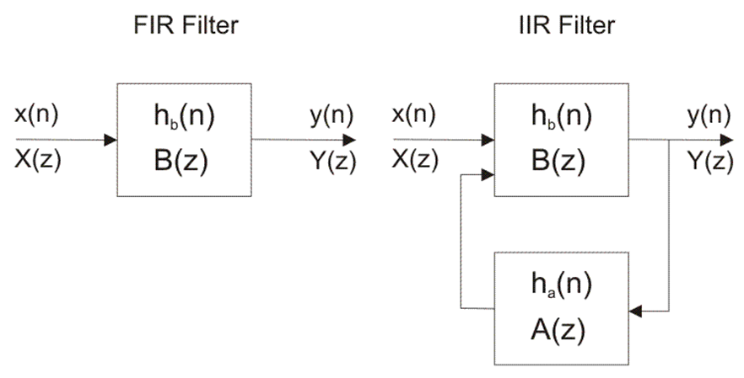
IIR Filters :
IIR filters are digital filters with infinite impulse response. Unlike FIR filters, the output is fed back to the input and are therefore known as recursive digital filters.

Slide 9
Choice of FIR over IIR
Because of feedback present in IIR, they are somewhat difficult to control.
FIR filter consume low power and IIR filter need more power due to more coefficients in the design.
IIR filters require more adders and multipliers.
FIR filter have linear phase characteristics whereas IIR are non linear.

Slide 10
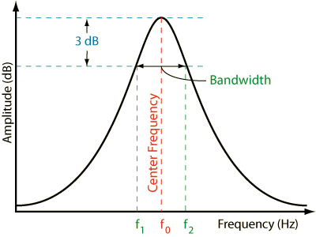
Band Pass Filter:
A band-pass filter is a device that passes frequencies within a certain range and rejects (attenuates) frequencies outside that range.
Fig: A Band Pass Filter

Slide 11
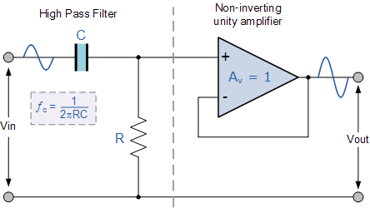
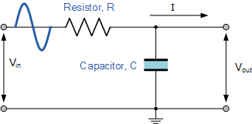
Low Pass Filters and High Pass Filters:
A Low Pass Filter is a circuit that can be designed to modify, reshape or reject all unwanted high frequencies of a signal and accept or pass only those signals wanted by the circuits designer.
A High Pass Filter is a circuit that can be designed to change or reject all unwanted low frequencies of a signal and accept or pass only those high freq. signals wanted by the circuits designer.

Slide 12
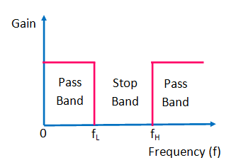
Band Stop Filter:
The Band Stop filter(band reject filter) blocks signals falling within a certain frequency band set up between two points while allowing both the lower and higher frequencies either side of this frequency band.
Formed by the combination of low pass and high pass filters with a parallel connection.
Fig: A Band Stop Filter Frequency Response

Slide 13
Significance of Order:
Advantages
More attenuation between the pass band and stop band
Narrow transition band.
Flatter pass band (less ripple)
Disadvantages
More compute intensive
Higher resource cost (SW or HW)
Longer group delay
High chance for instability in case of IIR filters
Higher dynamic range requiring more costly data format

Slide 14
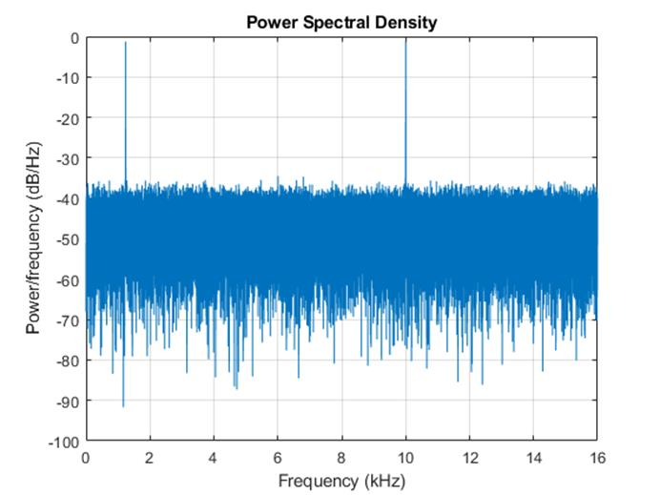
Power Spectral Density :
The Power Spectral Density (PSD) of a signal shows us the spectral energy distribution per unit time over a large enough time period. . This can be used to estimate the frequencies at which a signal is most powerful. In essence, one can identify the frequencies to filter out in case one wants to eliminate noise signals

Slide 15
Objective:
1. To study different filters and to design low pass, band pass, band stop and high pass filters.
2. To develop static FIR filters to filter noise from audio signal.
3. To equalize an audio signal channel taken at a particular sampling frequency demonstrates the entire method using FDAtool.

Slide 16
Tools Used:
MATLAB:
MATLAB is a programming language developed by MathWorks. It is based on a matrix programming language which made linear algebra programming simple.
MATLAB is widely used in engineering as it requires vast computations which can be made easier using it.
Few applications are:
Signal Processing and Communications
Image and Video Processing
Control Systems

Slide 17
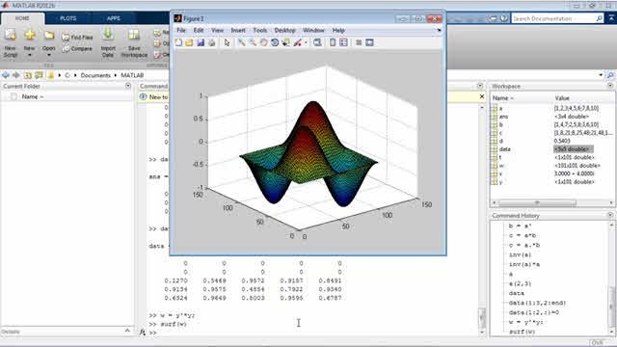

Slide 18
FDA Tool
The Filter Design and Analysis Tool (FDATool) is a powerful graphical user interface(G.U.I) in the signal processing toolbox for designing and analyzing filters quickly.
FDATool also provides tools for analyzing filters, such as magnitude and phase response and pole-zero plots.
To open FDAtool type >>fdatool in command window and the application will open.
The GUI has three main regions:
1. The Current Filter Information region
2. The Filter Display region and
3. The Design panel

Slide 19
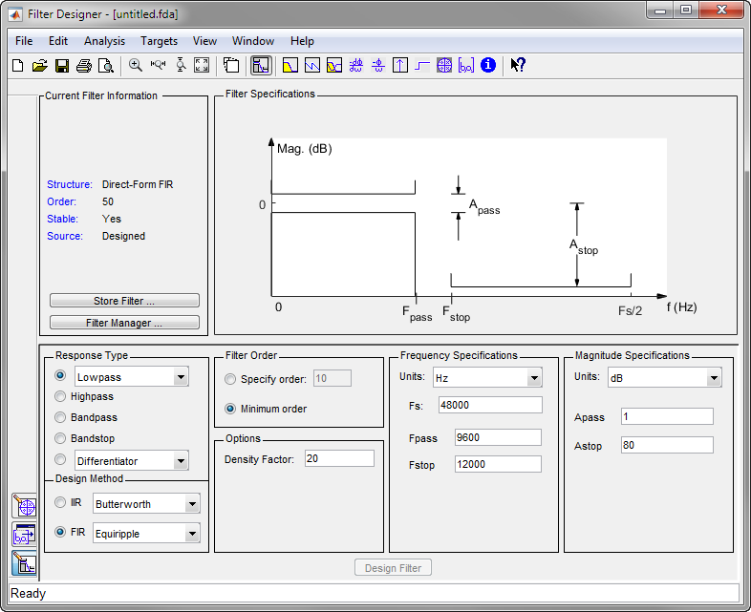

Slide 20
Process of Designing an FIR Filter
Take voice input using audiorecorder function.
Obtain array data from recorded signal and store in a variable x.
Declare noise signal y. This can be either sinusoidal with a fixed frequency, or other signals whose frequencies are not yet determined.
Using pwelch, plot and determine frequencies at which noise signals are most potent. Note the frequency range.
Mix signals x and y. Thus, we obtain the input, r, to the filter comprising of both voice input and noise signals.

Slide 21
Continued..
Using FDAtool, design the desired filter by entering the requisite parameters. The frequency pass parameter will be set at 4 kHz in case of human voice signal.
In order to filter out the noise, enter the frequencies observed in the pwelch plot in the stop frequency parameter of the filter. This will ensure that the noise gets filtered out.
The sampling frequency is set at a value at least greater than two times the maximum human hearing frequency i.e. 40 kHz in accordance to the sampling theorem.
On designing the filter , import the coefficients to the workspace under the desired variable name, say, a.
Convolute the input signal r and the filter coefficients a. Observe the output using the sound function. You shall obtain a noise free signal.

Slide 22
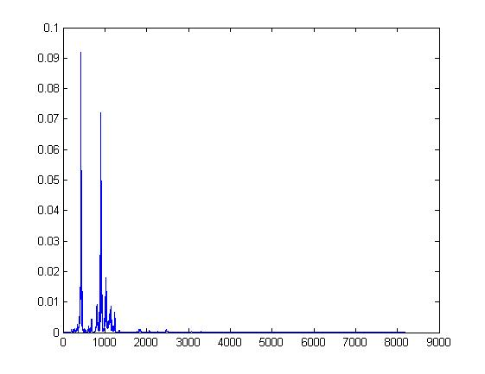
Simulation Result:
PSD of Input voice signal

Slide 23
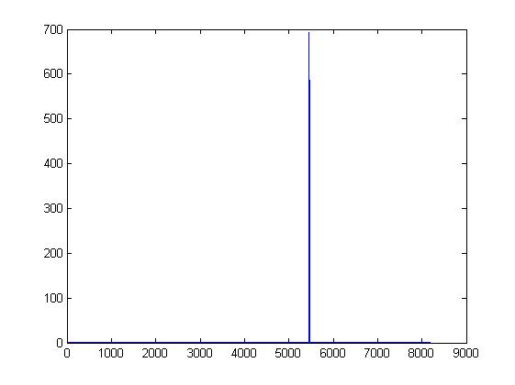
PSD of Noise

Slide 24
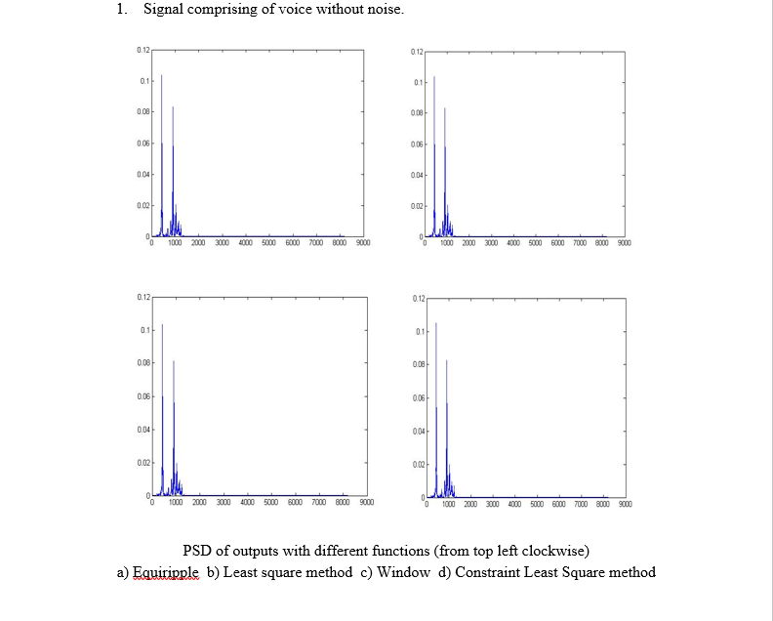
Output Signals

Slide 25
Future Scope:
Extension of realised objectives to obtain adaptive filters using algorithms such as least mean squares (LMS) and recursive least squares (RLS) in order to filter out noise with changing frequency.
Realisation of channel equaliser using adaptive filters both digitally as well as physically using LABView, Code Compare Studio (CCS-5) and DSK6713.

Slide 26
THANK YOU

